Slide 1

Autoregression using ANN with Neuralprphet
Dr. Siddhaling Urolagin

Slide 2

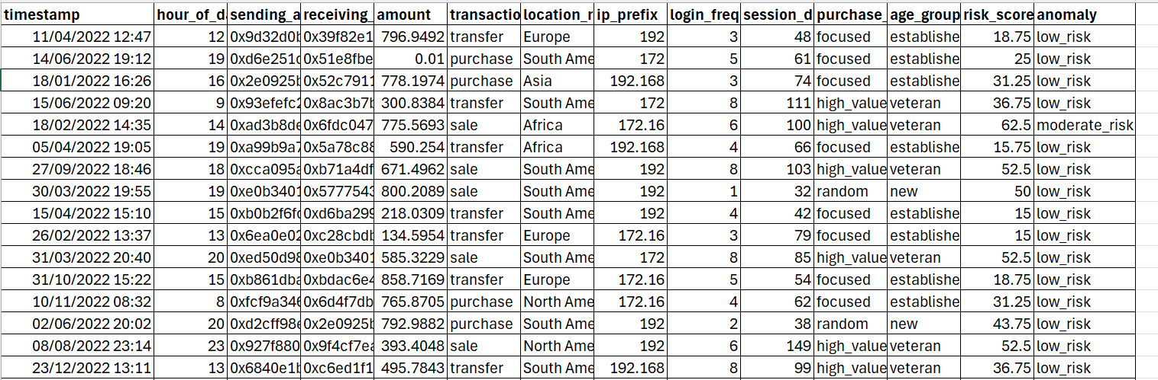
Data set

Slide 3
Fraud Detection
timestamp
hour_of_day
sending_address
receiving_address
amount
transaction_type
location_region
ip_prefix
login_frequency
session_duration
purchase_pattern
age_group
risk_score
anomaly

Slide 4
Tasks
Install neuralprophet
Convert timestamp to datetime and set as index
Develop neuralprophet to perform 'risk_score' for forecasting
Read the CSV file then print df.info()
Select only the numeric column 'risk_score' for forecasting
Resample data daily
Prepare the dataset for NeuroProphet
Split dataset into training and test sets

